Slide 3


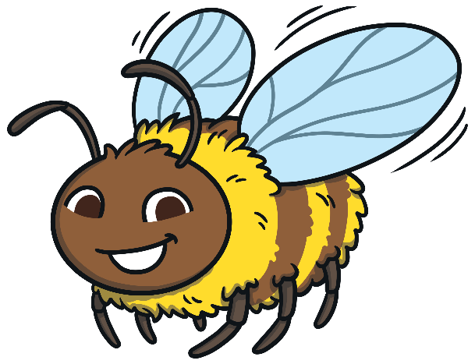
Let’s Learn About Pollination!
There are lots of colourful flowers in my garden that I like to visit.
Welcome to my garden!
I can see some lovely flowers!
Do you know why bees like to visit flowers?

Slide 4

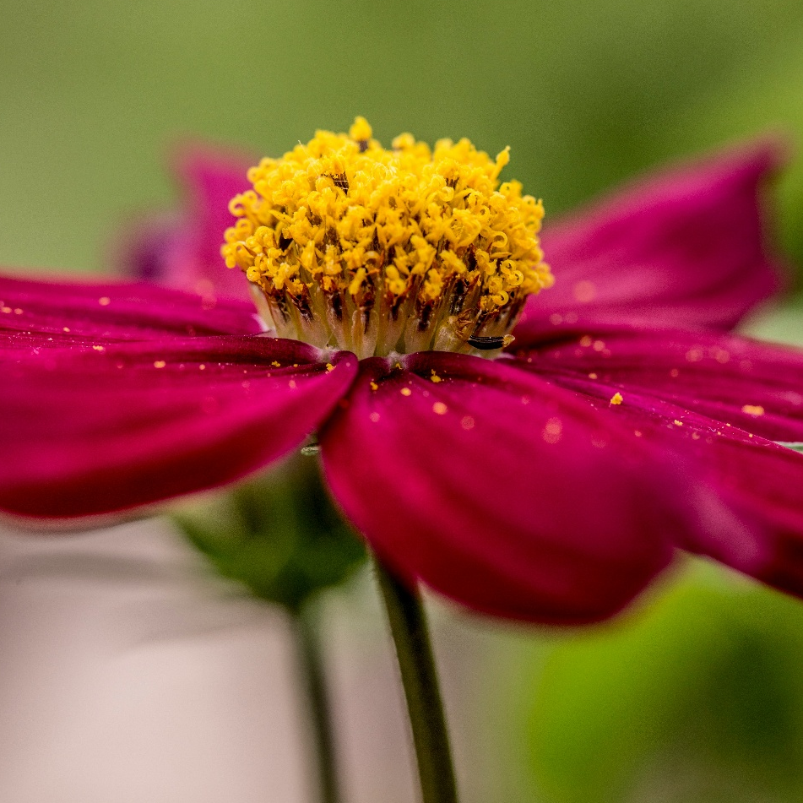
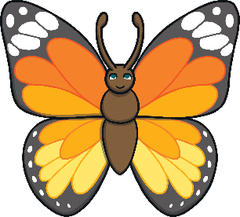
Flowers
Flowers have lots of different parts.
pollen
What parts can
you see on this flower?
Where is the pollen on this flower?
Pollen can be found in some flowers on plants and trees (which are large plants).
It is usually yellow or white
and looks a bit like dust.
Can you see some yellow pollen?
stem

Slide 5
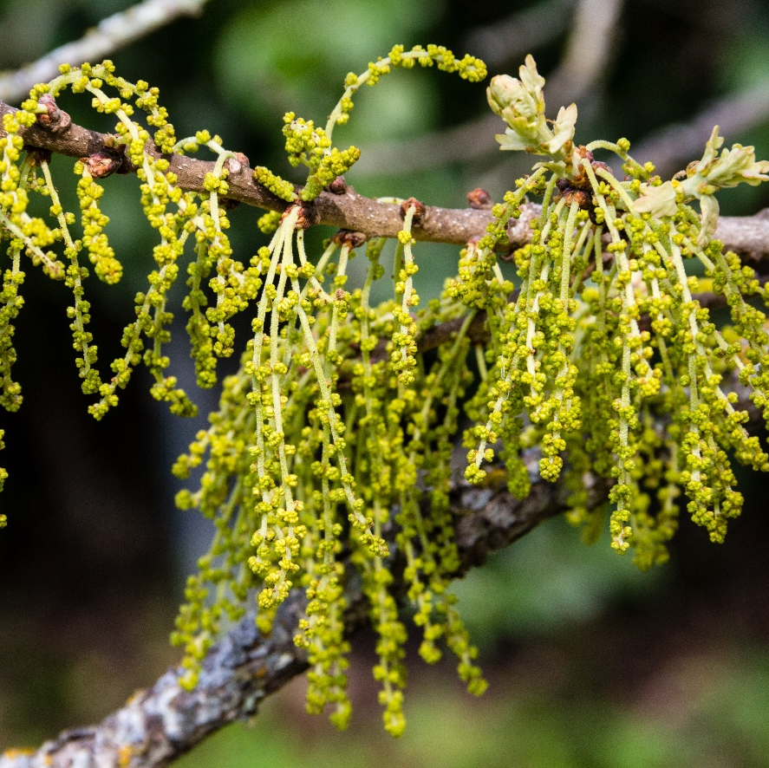
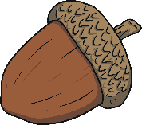
To help plants grow seeds and fruits, they need pollen. So, it’s important that pollen is spread between flowers.
Pollination
oak tree pollen
The wind and animals can help with pollination.
This is called pollination.
The wind can
help to spread the pollen on some trees, such as oak trees.
After pollination, colourful flowers will turn into acorns. New oak trees can grow from these acorns.

Slide 6
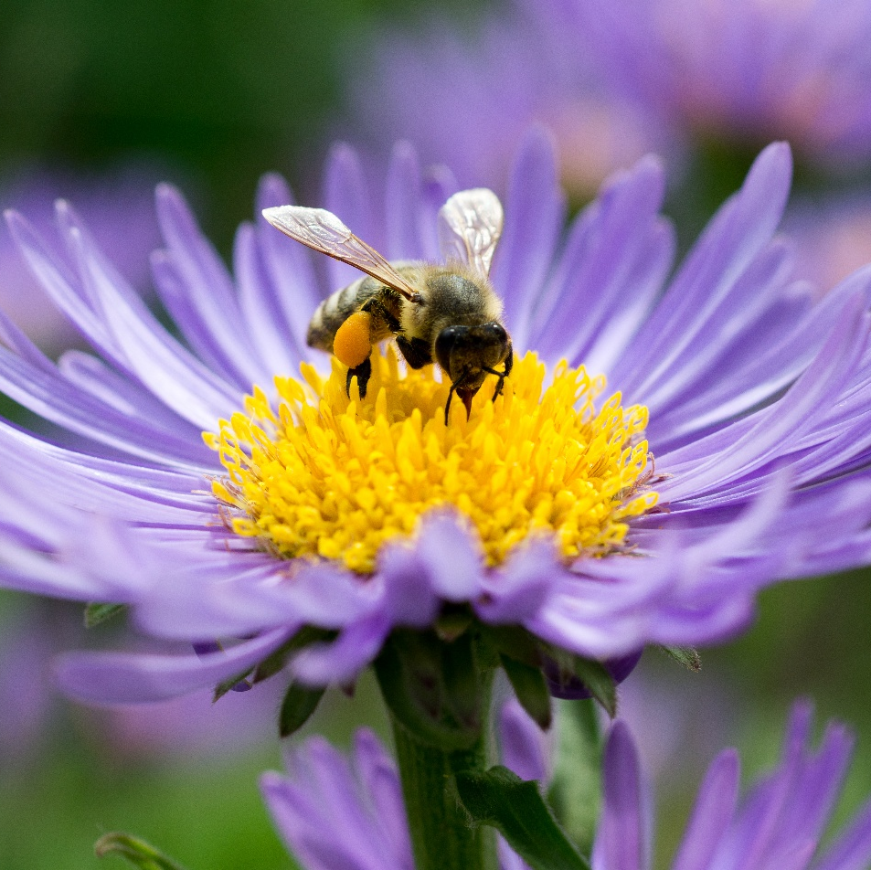
Bees are a type of minibeast that can help with pollination.
Pollinators – Bees
Bees fly from flower to flower
and collect pollen.
pollen basket
Some bees (such as bumblebees and honeybees) collect pollen on their furry bodies and push it
into special pockets on their back legs.
Can you see the pollen basket on the bee in the photo?
pollen

Slide 7
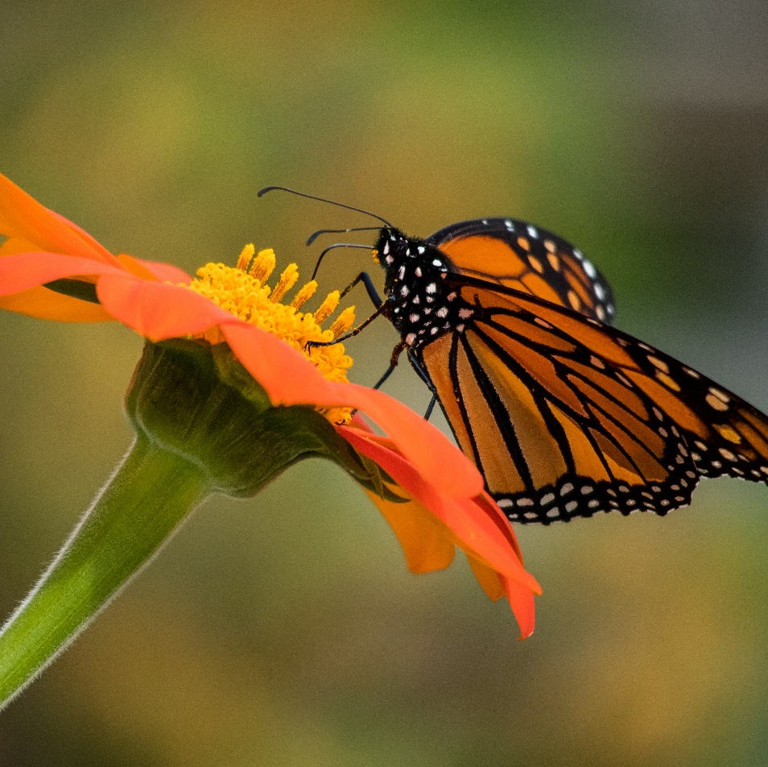
Butterflies are another type of minibeast
that can help with pollination.
Pollinators – Butterflies
As butterflies feed on nectar inside some flowers, pollen sticks to their legs and bodies.
proboscis
The pollen gets spread to other flowers
as the butterflies fly to different places.
Fun fact!
Butterflies use a long,
curled tube called a proboscis
to drink the nectar – it’s a bit
like a straw!
Nectar is a sweet liquid found inside a flower.
pollen

Slide 8
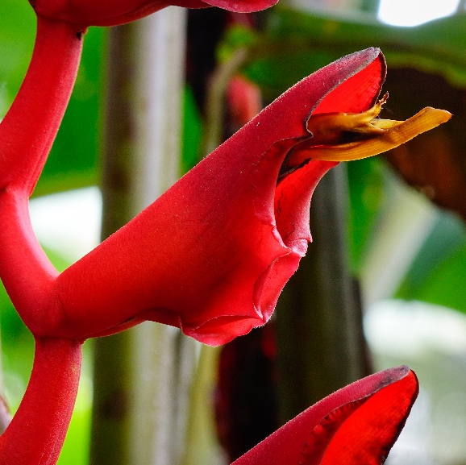
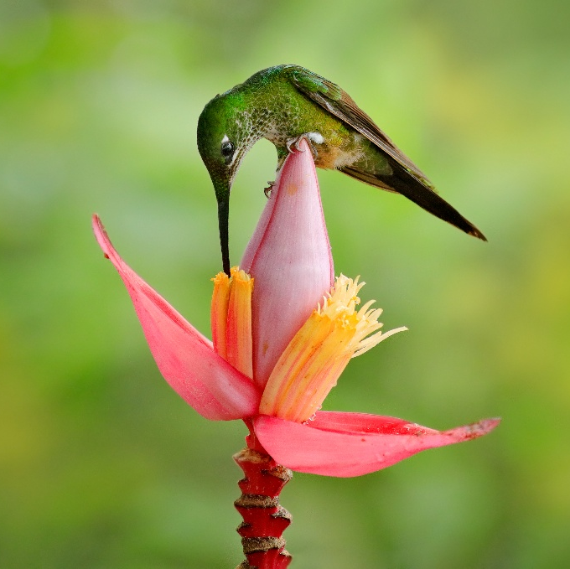
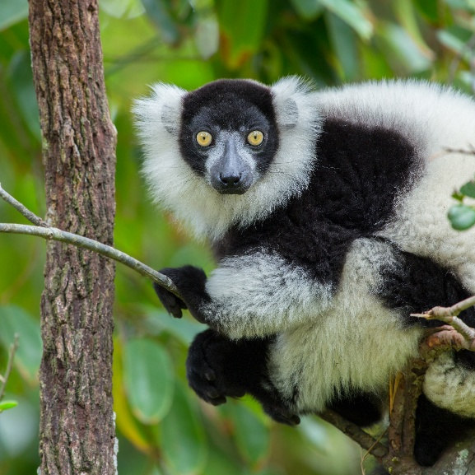
Sometimes, other animals can also help with pollination.
Some birds can help with pollination, too.
Other Pollinators
For example, hummingbirds help to spread pollen as they dip their beaks and heads into flowers to drink nectar.
For example, when lemurs eat the nectar inside some palm flowers, they get pollen
on their long snouts and fur.

Slide 9
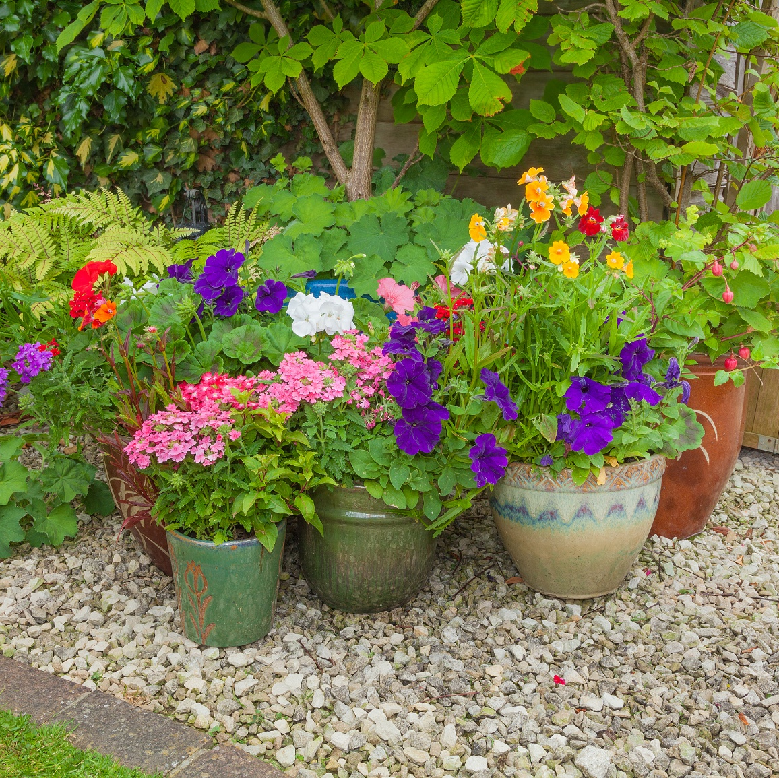
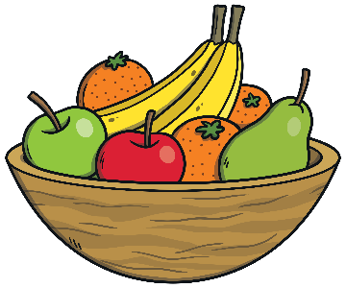
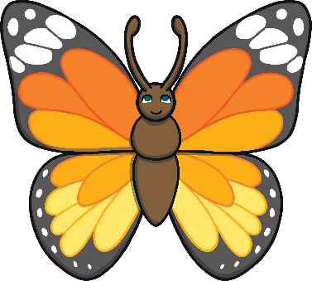
Pollination is important as it helps plants grow seeds and fruits.
Why Is Pollination Important?
This includes food for us to eat,
such as fruits and vegetables.
Pollination also means that
new plants can grow in
different places around the world.
I wonder which pollinators would visit this garden.

Slide 10
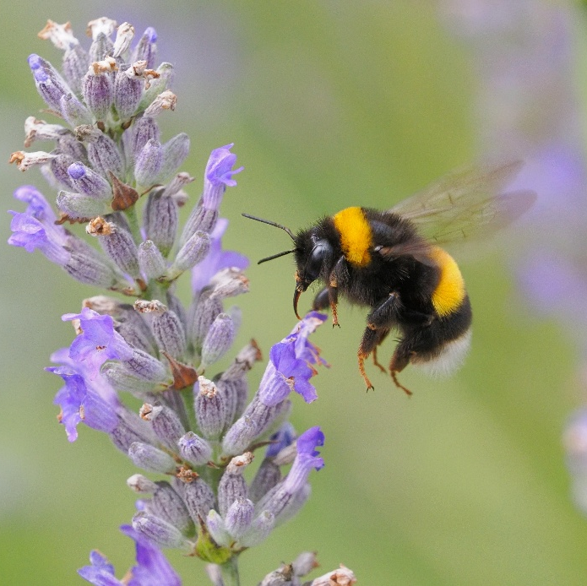
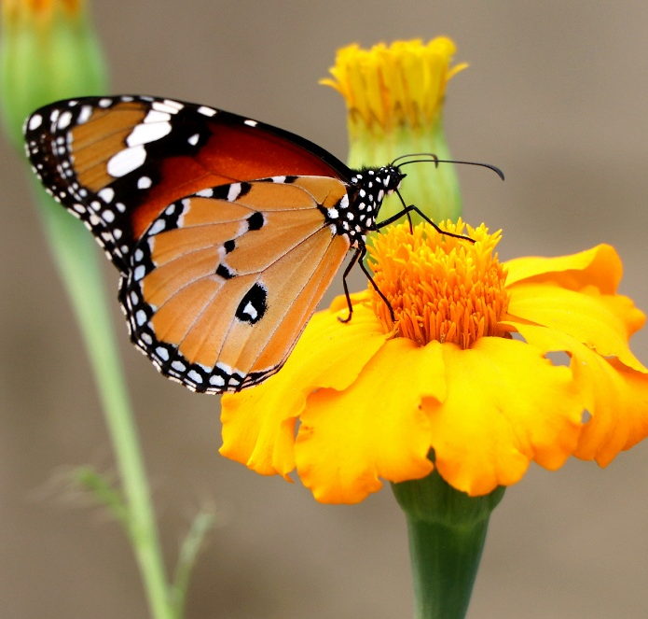
We can help pollinators, such as bees,
by planting seeds and flowers.
You could plant some wildflower seeds in your garden.
Helping Pollinators
Or, plant some flowers in pots at school and watch
to see if any bees or butterflies come to visit!
My butterfly friends and I love marigold and cosmos flowers.
My bee friends and I love lavender and mint.

Slide 11

What Did You Learn?
What did you learn about pollination?
What could you do to help pollinators?
Can you tell a friend about pollination?

